Slide 1
Data rate limits
How fast data can be sent ?
It depends on three factors:
Bandwidth of the channel
Numbers of levels used in signals
Noise level in the signal

Slide 2
Bandwidth of a medium
Bandwidth refers to the range of frequencies that a medium can pass without a loss of one-half of the power contained in a signal.
Attenuation
B = F _{h} - F _{l}

Slide 3
Digital signal requires low-pass channel
Bandwidth of a medium decides the quality of the signal at the other end.
A digital signal (usually Aperiodic ) requires a bandwidth from 0 to infinity. So, it needs a low pass channel.
Amplitude
Low Pass Channel
0
f

Slide 4
Analog signals require a band-pass Channel
Amplitude
Band pass
Channel
f1
f2

Slide 5
Attenuation Distortion
Attenuation varies as a function of frequency
This is known as Attenuation distortion
Example: Voice grade telephone line
10 dB
Attenuation
0
Equalizer
-10 dB
1000 2000 3000 4000 Hz
Solution is to use Equalizer
Problem is less in case of digital signal

Slide 6
Delay Distortion
Arises in case of Guided Media
Velocity of Propagation varies with frequency
This lead to Delay distortion
Effects can be minimized using equalizer
Digital Signal is more effected.
4000
Equalizer
0
1000 2000 3000 4000 Hz

Slide 7
Nyquist Bit Rate
Noiseless channel
In case of noiseless channel, the maximum bit rate is given by Nyquist bit rate
Bit rate C= 2.B.Log₂L
Where C is known as channel capacity ,
B is the bandwidth of the channel
L is the number of signal levels used

Slide 8
Baud rate
The Baud rate or the signaling rate is defined as the number of distinct symbols transmitted per second, irrespective of the form of encoding.
For the baseband digital transmission L=2,
0v
0.5v
1v
2v
0v
1v
4 Values
2 Values
Bit interval

Slide 9
Bit rate
The bit rate or the information rate I is the actual equivalent number of bits transmitted per second.
I = Baud rate x Bits per baud
= Baud rate x N
= Baud rate x log₂ M
For binary encoding ,bit rate and baud rate are the same i.e.,
I = Baud rate

Slide 10
Example
Let us consider a telephone channel having bandwidth B= 4 KHz. Assuming there is no noise, determine channel capacity for the following encoding levels:
2
128
(i) C = 2.B.log₂2 = 2x4000 = 8 Kbits/s
(ii) C= 2x4000xlog₂128 = 8000x7 = 56 Kbits/s
Multilevel encoding-Modems

Slide 11
Effect of Noise
When there is noise present in the medium, the limitation of both bandwidth and noise must be considered.
Transmitted
Received
1 __
0.5__
0 __
0.5
1v
Noise
0.5

Slide 12
A noise spike may cause a given level to be interpreted as the signal of greater level if it is in positive phase or a smaller level if it is negative phase.
Noise becomes more problematic as the number of levels increases.

Slide 13
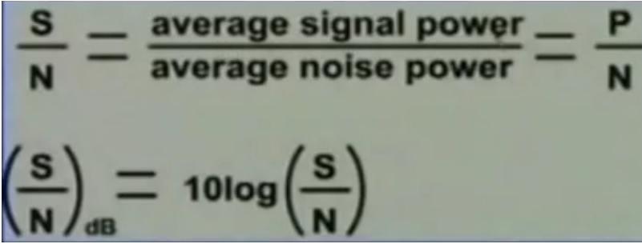
Signal to Noise Ratio
Let P = average signal power
Let N = average noise power

Slide 14
Shannon capacity(Noisy channel)
Shannon capacity gives the highest data rate for a noisy channel
C= B x log₂ (1+S/N)
Where S/N is signal to noise ratio
In case of extremely noisy channel , C=0
Between the Nyquist bit rate and the Shannon capacity, the result providing the smallest channel capacity is the one that establishes the link.

Slide 15
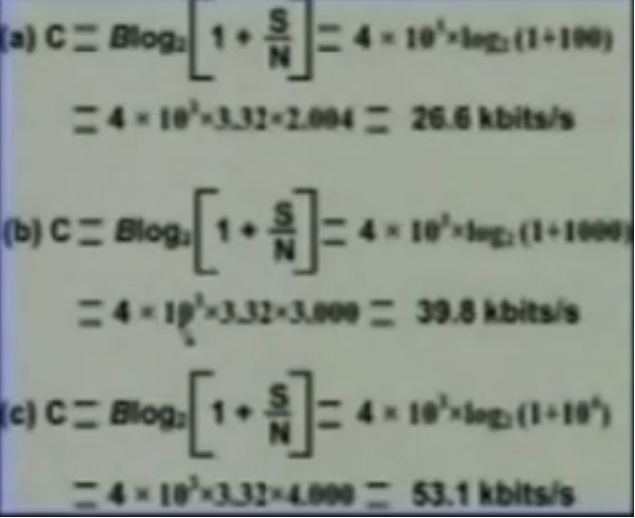
Examples
A channel has B= 4Khz.Determine the channel capacity for each of the following signal to the noise ratios :
20dB
30dB
40dB.

Slide 16
Example
A channel has a B=4KHz and signal to noise ratio of 30 dB. Determine maximum information rate for 4 level encoding.
For B= 4KHz and 4 level Encoding
Nyquist Bit rate= 16Kbps
Again for B=4KHz and S/N ratio of 30dB
Shannon capacity = 39Kbps
The smallest of the two values has to be taken as the information capacity
C=16 Kbps

Slide 17
Example
A channel has a B=4KHz and signal to noise ratio of 30 dB. Determine maximum information rate for 128 level encoding.
Nyquist Bit Rate for B=4KHz and M=128 levels Encoding
Nyquist Bit rate= 56Kbps
Shannon Capacity for B=4KHz and S/N ratio of 30dB
Shannon capacity = 39Kbps
The smallest of the two values has to be taken as the information capacity
C=39 Kbps

Slide 18
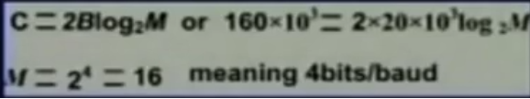
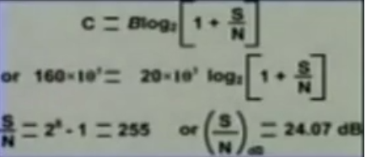
Example
The digital signal is designed to permit 160 Kbps for the bandwidth of 20KHz.Determine (a)number of levels and (b)S/N ratio.
(a) Apply Nyquist Bit rate to determine number of levels
(b) Apply Shannon capacity to determine the S/N ratio

Slide 19
Noise
Several type of noise may corrupt the signal
Common Noise Types:
Thermal : N=k.T.B
Intermodulation: occurs when signal of different frequency share the same medium
Crosstalk: It is due to unwanted coupling between two media.
Impulse noise: Arises due to disturbances such as lightening, electrical sparks. Digital signals are more effected than Analog Signals

Slide 20
Performance
Bandwidth
Throughput
Latency (delay)
4) Jitter

Slide 21
1) Bandwidth
Bandwidth in Hertz- Range of frequencies contained in a composite signal.
OR The range of frequencies a channel can pass.
Bandwidth in bits per second-
No. of bits per second that a channel can pass.
For example –Bandwidth of Bandwidth of a fast Ethernet network can be 100Mbps

Slide 22
2) Throughput
Actual received speed.
1 Mbps Bandwidth
200 kbps Throughput
1000/100 car Example

Slide 23
3) Latency
Latency= Propagation time + Transmission time + Queuing Time + Processing Delay
Propagation time
Transmission time
Queuing time
Processing delay

Slide 24
Propagation time
Measures the time required for a bit to travel from the source to the destination.
Propagation time= Distance/Propagation Speed

Slide 25
Transmission time
Time Between the first bit leaving the sender and the last bit arriving at receiver.
The first bit leaves earlier and arrives earlier.
The last bit leaves later and arrives later
Transmission time=Message size/ Bandwidth

Slide 26
Queuing time
An intermediate device such as a router, queues the arrived messages and processes them one by one. If there are many messages, each message will have to wait.
Delay time
Time between 1st and the last bit during transmission.

Slide 27
4) Jitter
Jitter is a problem – If different packets of data encounter different delays.
For example- Audio/video data
Delay- 1st packet =20ms,
2nd =45ms,
3rd = 40ms

